Slide 1
Open Web Application Security Project (OWASP Top 10 for 2017)
Title Slide
Heading
• Font: Calibri, 32 pt, Bold
• Color: White
Secondary Heading
• Font: Calibri, 18 pt
• Color: White
Date
• Font: Calibri, 16 pt
• Color: White
NO SLIDE NUMBER
Click on the corner of this text box to delete
Secure Development Practices
July 30 and 31 , 2019
Presenter: Venkatesh Reddy Madduri

Slide 2
OWASP - Introduction
OWSAP [ Open Web Security Application Project] Foundation come online on December 1st 2001 and it was established as a non-profit charitable organization in USA on 21st April, 2004.
OWSAP dedicated to all aspects of web application security. OWASP is in a unique position to provide practical information about Application Security to individuals, corporations, universities, government agencies and other organizations worldwide. Operating as a community of like-minded professionals, OWASP issues software tools and knowledge-based documentation on application security.
The primary aim of the OWASP Top 10 is to educate developers, designers, architects, managers, and organizations about the consequences of the most common and most important web application security weaknesses. The Top 10 provides basic techniques to protect against these high risk problem areas, and provides guidance on where to go from here.
Every 3 years, a compilation of the most prevalent security attacks against web applications is created and labeled as the Top 10.

Slide 3
OVERVIEW OF OWASP TOP 10 2017
Overview of “The Top 10 Most Critical Web Application Security Risks”
The OWASP Top 10 is a powerful awareness document for web application security. It represents a broad consensus about the most critical security risks to web applications. Project members include a variety of security experts from around the world who have shared their expertise to produce this list.
The OWASP Top 10 -2017 is based primarily on 40+ data submissions from firms that specialize in application security and an industry survey that was completed by over 500 individuals. This data spans vulnerabilities gathered from hundreds of organizations and over 100,00 real-world applications and APIs. The Top 10 items are selected and prioritized according to this prevalence data, in combination with consensus estimates of exploitability, detectability, and impact.
We urge all companies to adopt this awareness document within their organization and start the process of ensuring that their web applications minimize these risks. Adopting the OWASP Top 10 is perhaps the most effective first step towards changing the software development culture within your organization into one that produces secure code.
Check OWASP Developer’s Guide , OWASP Cheat Sheet Series and OWASP Testing Guide to get more exposure.
For establishing strong application security controls, the OWASP Proactive Controls project provides a starting point to help developers build security into their application and OWASP Application Security Verification Standard(ASVS) is a guide for organizations and application reviewers on what to verify.

Slide 4
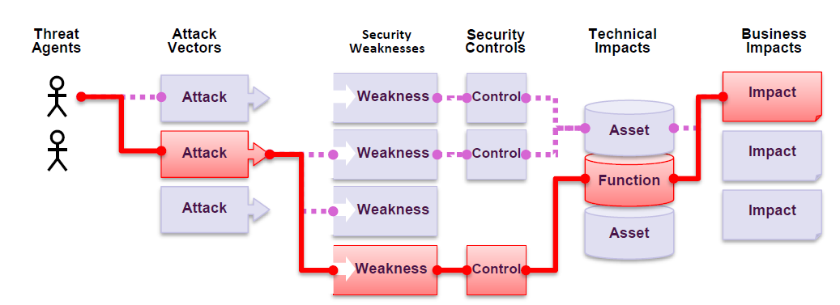
Risk – Application Security Risks
Attackers can use many different paths through the application to do harm to your business or organizations. Each of these paths represents a risk that may, or may not, be serious enough to warrant attention.
Sometimes these paths are trivial to find and exploit, and sometimes they are extremely difficult. Similarly, the harm that is caused may be of no consequence, or it may put you out of business. To determine the risk to your organization, you can evaluate the likelihood associated with each threat agent, attack vector, and security weakness and combine it with an estimate of technical and business impact to your organization. Together, these factors determine your overall risk.

Slide 5
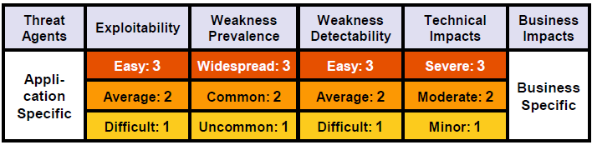
Risk – Application Security Risks
The OWSAP Top 10 focuses on identifying the most serious web application security risks for a broad array of organizations. For each of these risks, we provide generic information about likelihood and technical impact using the following simple ratings scheme, which is based on the OWSAP Risk Rating Methodology.
Risk = Likelihood * Impact
Each organization is unique, and so are the threat actors for that organization, their goals, and the impact of any breach. The names of Top 10 are aligned with Common Weakness Enumeration (CWE) weaknesses to promote generally accepted naming conventions and to reduce confusion.

Slide 6
OWASP TOP 10 2017
OWASP TOP 10 for 2017 LISTED
A1: 2017 - Injection
A2: 2017 - Broken Authentication
A3: 2017- Sensitive Data Exposure
A4: 2017 – XML External Entities (XXE)
A5: 2017 – Broken Access Control
A6: 2017 – Security Misconfiguration
A7: 2017 – Cross Site Scripting
A8: 2017 – Insecure Deserialization
A9: 2017 - Using Components with Known Vulnerabilities
A10: 2017 -Insufficient Logging & Monitoring
Click here for the answer

Slide 7
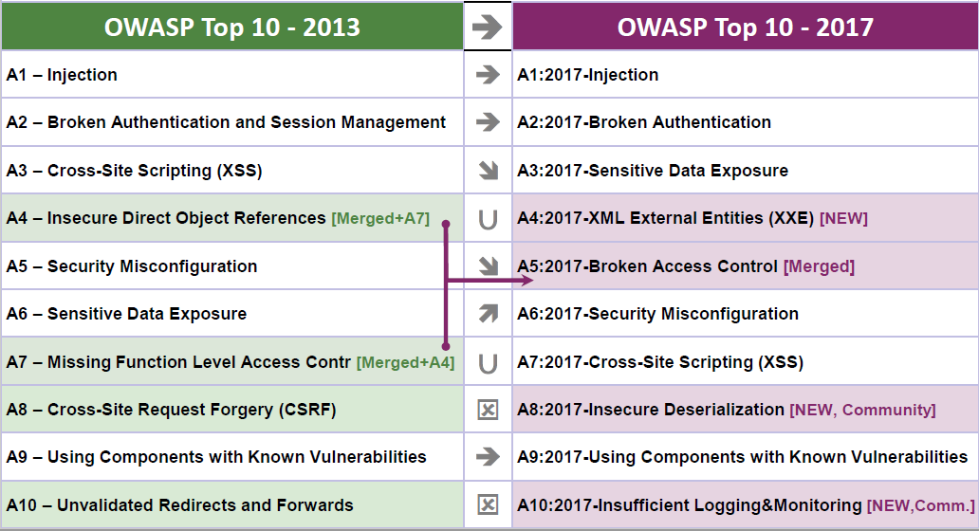
WHAT CHANGED FROM VERSION 2013 TO 2017?
3 NEW ADDITIONS, MERGED AND PRIORITY CHANGES FROM OWASP TOP 10 2017
Click here for the answer

Slide 8
A1: 2017 - Injection
What is Injection:
An attacker supplies untrusted input to a program. This input gets processed by an interpreter as part of a command or query. In turn, this alters the execution of that program.

Slide 9
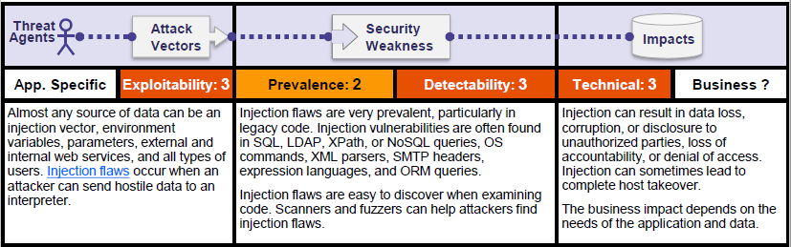
A1: 2017 - Injection
Risk Matrix

Slide 10
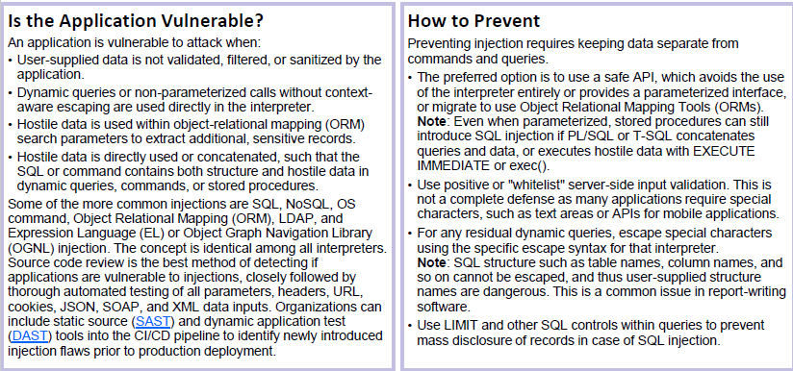
A1: 2017 - Injection

Slide 11
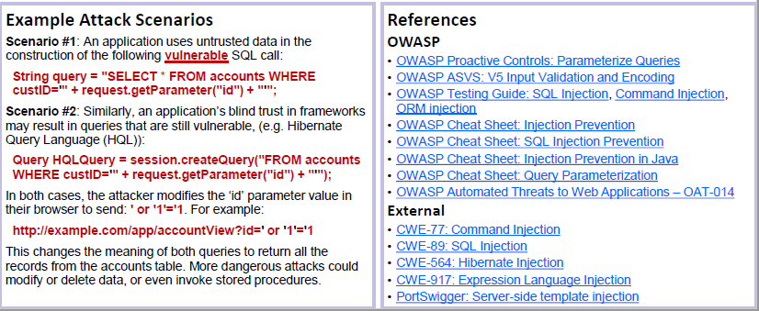
A1: 2017 - Injection

Slide 12
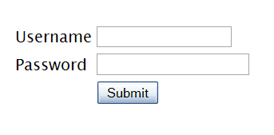
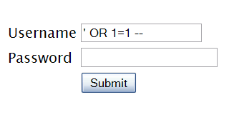

A1: 2017 – Injection Exploit
INJECTION ILLUSTRATED
"SELECT * FROM accounts WHERE acct=‘’ OR 1=1--’"
Illustrated
Account Summary
Acct:5424-6066-2134-4334
Acct:4128-7574-3921-0192
Acct:5424-9383-2039-4029
Acct:4128-0004-1234-0293
Account:
Account:
SKU:
DB Table 

SKU:
HTTP response 

HTTP request
SQL query
Application Layer
Finance
Transactions
Accounts
Administration
Communication
Knowledge Mgmt
E-Commerce
Bus. Functions
Databases
Legacy Systems
Web Services
Directories
Billing
Human Resrcs
APPLICATION ATTACK
Custom Code
1. Application presents a form to the attacker
2. Attacker sends an attack in the form data
App Server
3. Application forwards attack to the database in a SQL query
Web Server
4. Database runs query containing attack and sends encrypted results back to application
Hardened OS
Network Layer
Firewall
Firewall
5. Application decrypts data as normal and sends results to the user

Slide 13
A1 – 2017 Injection - Prevention
PREVENTING INJECTION USING PREPARED STATEMENT
A1: Injection
String query = “SELECT * FROM employee WHERE userid = ? and password = ? ”;
try {
Connection connection = WebSession.getConnections(s);
PreparedStatement statement = connection.prepareStatement(query,
ResultSet.TYPE_SCROLL_INSENSITIVE, ResultSet.CONCUR_READ_ONLY);
statement.setString(1, userId);
statement.setString(2, password);
ResultSet answer_results = statement.executeQuery();

Slide 14
A1: 2017 - Injection
PREVENTING INJECTION USING PREPARED STATEMENT
A1: Injection
Strongly typing non-string parameters
String query = "SELECT userid FROM employee WHERE id = ? AND date_created >= ? “;
try
{
Connection connection = WebSession.getConnections(s);
PreparedStatement statement = connection.prepareStatement(query,
ResultSet.TYPE_SCROLL_INSENSITIVE, ResultSet.CONCUR_READ_ONLY); myPrepStmt = conn.prepareStatement
statement.setInt(1, validatedUserId);
statement.setDate(2, validatedStartDate);
...

Slide 15
A1: 2017 - Injection
LDAP Injection
A1: Injection
searchfilter = “(cn=“+user+”)”
Which is instantiated by an HTTP request like this:
http://www.fis.com/ldapsearch?user=John
If the value ‘John’ is replaced with a ‘*’, by sending the request:
http://www.fis.com/ldapsearch?user=*
The filter will look like
searchfilter = “(cn=*)”
If the application is vulnerable to LDAP injection, it will display some or all of the users' attributes, depending on the application's execution flow and the permissions of the LDAP connected user.
A tester could use a trial-and-error approach, by inserting in the parameter '(', '|', '&', '*' and the other characters, in order to check the application for errors.
After encoding using ESAPI library it would be as (cn=\2a)

Slide 16
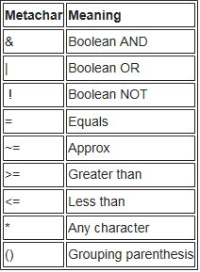
A1: 2017 - Injection
LDAP Injection
A1: Injection
Login:
searchlogin= "(&(uid="+user+")(userPassword={MD5}"+base64(pack("H*",md5(pass)))+"))";
Where:
user=*)(uid=*))(|(uid=* pass=password
searchlogin="(&(uid=*)(uid=*))(|(uid=*)(userPassword={MD5}X03MO1qnZdYdgyfeuILPmQ==))";
This user will always will be logged in as 1st user.
Before encoding (&(uid=user=*)(uid=*))(|(uid=*)(userPassword=password))
After encoding (&(uid=user=\2a\29\28uid=\2a\29\29\28|\28uid=\2a)(userPassword=password))

Slide 17
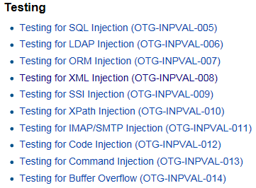
A1: 2017 - Injection
Other Injection References
A1: Injection
https://www.owasp.org/index.php/OWASP_Top_Ten_Cheat_Sheet
http://blog.securelayer7.net/owasp-top-10-penetration-testing-soap-application-mitigation/

Slide 18
A2: 2017 – Broken Authentication
What is Broken Authentication
Can allow an attacker to either capture or bypass the authentication methods that are used by a web application.
User authentication credentials are not protected when stored.
Predictable login credentials.
Session IDs are exposed in the URL (e.g., URL rewriting).
Session IDs are vulnerable to session fixation attacks(hijack valid session id and using it)
Session value does not timeout or does not get invalidated after logout.
Session IDs are not rotated after successful login.
Passwords, session IDs, and other credentials are sent over unencrypted connections.

Slide 19
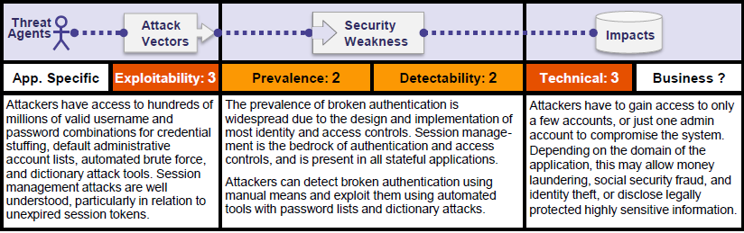
A2: 2017 – Broken Authentication
Risk Matrix

Slide 20
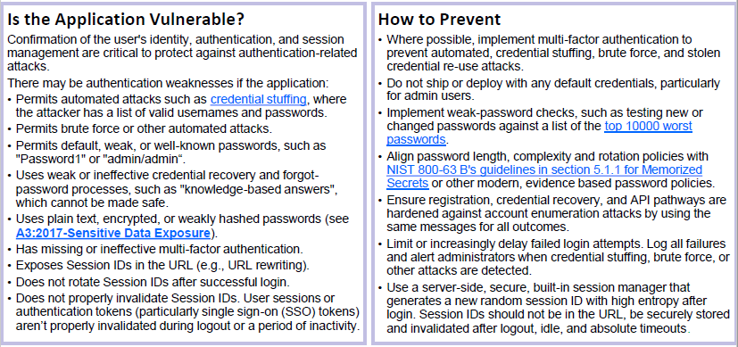
A2: 2017 – Broken Authentication

Slide 21
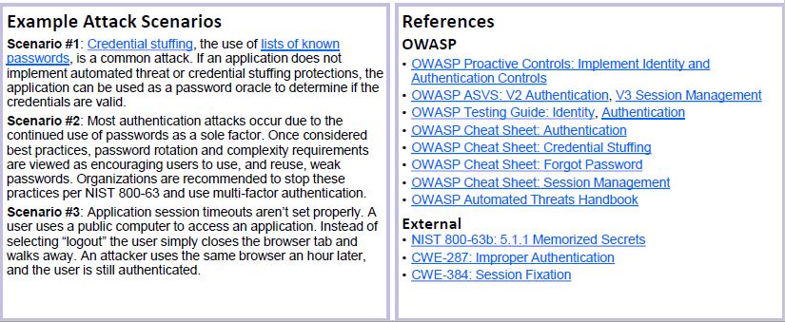
A2: 2017 – Broken Authentication

Slide 22

A2: 2017 – Broken Authentication
BROKEN AUTHENTICATION AND SESSION MANAGEMENT
HTTP is a “stateless” protocol
Means credentials have to go with every request
Should use TLS for everything requiring authentication
Session management flaws
SESSION ID used to track state since HTTP doesn’t
and it is just as good as credentials to an attacker
SESSION ID is typically exposed on the network, in browser, in logs, …
Beware the side-doors
Change my password, remember my password, forgot my password, secret question, logout, email address, etc…
Typical Impact
User accounts compromised or user sessions hijacked

Slide 23
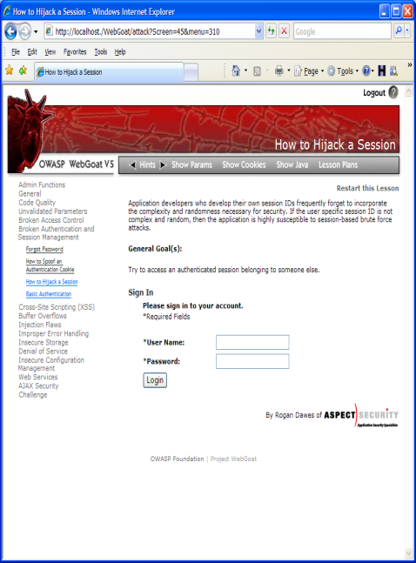

A2: 2017 – Broken Authtentication
BROKEN AUTHENTICATION AND SESSION MANAGEMENT ILLUSTRATED
1
User sends credentials
www.boi.com?JSESSIONID=9FA1DB9EA...
Finance
Transactions
Accounts
Administration
Communication
Knowledge Mgmt
E-Commerce
Site uses URL rewriting
(i.e., put session in URL)
Bus. Functions
2
Custom Code
3
User clicks on a link to http://www.hacker.com in a forum
Hacker checks referrer logs on www.hacker.com
and finds user’s JSESSIONID
4
Hacker uses JSESSIONID and takes over victim’s account

Slide 24
A2: 2017 – Broken Authentication
PREVENTING BROKEN AUTHENTICATION AND SESSION MANAGEMENT
All authentication controls must be enforced on a trusted system (e.g., the server).
If the application manages a credential store the table/file that stores the passwords and keys must be writeable only by the application.
Passwords must be stored using one-way hashes.
Password hashing must be implemented on a trusted system (e.g., the server).
TLS must protect both credentials and session id at all times during and after login.
If a session was established before login, that session must be closed and a new session must be established after a successful login to prevent session fixation. This must also be done anytime re-authentication is required.
Session Id Name Fingerprint needs to be changed from the container’s defaults. For e.g.
The session ID names used by the most common web application development frameworks can be easily fingerprinted [0], such as PHPSESSID (PHP), JSESSIONID (J2EE), CFID & CFTOKEN (ColdFusion), ASP.NET_SessionId (ASP .NET), etc. Therefore, the session ID name can disclose the technologies and programming languages used by the web application.
It is recommended to change the default session ID name of the web development framework to a generic name, such as “id”

Slide 25
A2: 2017 – Broken Authentication
PREVENTING BROKEN AUTHENTICATION AND SESSION MANAGEMENT
8. The session ID length must be at least 128 bits (16 bytes).
Session identifiers must not be exposed in URLs or in error messages to the user.
Session ids should be unpredictable for prevent guessing attacks and session id value should be meaningless.
All Sessions ids should be expired at certain interval of time even though session is active.
Idle timeout, Absolute Timeout and Renewal Timeout.
12. All session termination including Logout must fully terminate the applications session and connection
All allocated resources must be released.
Implement necessary cache-control headers to avoid accessing secure pages even after logout. “Cache-Control: no-cache="Set-Cookie, Set-Cookie2"

Slide 26
A2: 2017 – Broken Authentication
PREVENTING BROKEN AUTHENTICATION AND SESSION MANAGEMENT – CONT.
Session inactivity timeout must not exceed 15 minutes
*Licensed applications should use 15 minutes as a default session inactivity timeout.
If the application needs to pass the session ID it must pass it in cookie instead of in a URL parameter.
Applications must not create persistent authentication cookies.
Applications must set the HTTPOnly attribute for session cookies. Other cookies must be set HTTPOnly unless client-side scripts are required to have the ability to read or set the cookie’s value.
All Cookies must set to Secure, SameSite, Domain and Path , Expire and Max-Age Attributes
Applications must not allow concurrent logins from the web or mobile user interfaces for the same user ID. [Effective June 30th, 2016]
* PCI mandates 15 minutes timeout. Regulatory compliance has a precedence.

Slide 27
A3: 2017 – Sensitive Data Exposure
What is Sensitive Data Exposure
Sensitive Data Exposure occurs when an application does not adequately protect sensitive information. The data can vary and anything from passwords, session tokens, credit card data to private health data and more can be exposed

Slide 28
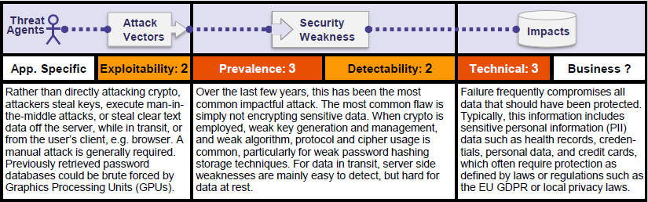
A3: 2017 – Sensitive Data Exposure
Risk Matrix

Slide 29
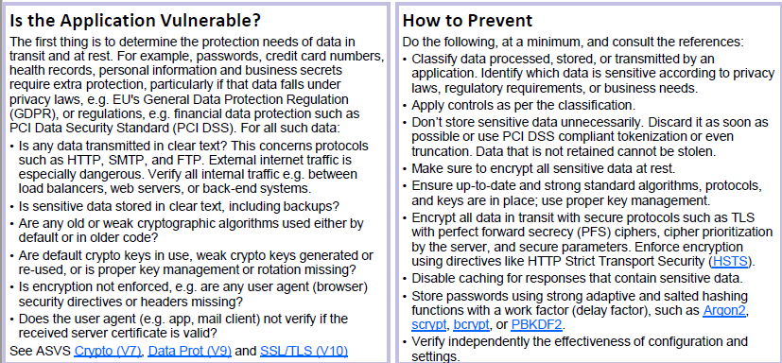
A3: 2017 – Sensitive Data Exposure

Slide 30
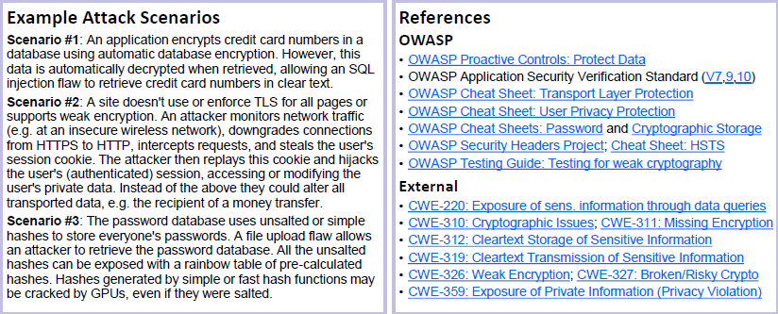
A3: 2017 – Sensitive Data Exposure

Slide 31
A3: 2017 – Sensitive Data Exposure
SENSITIVE DATA EXPOSURE
Storing and transmitting sensitive data insecurely
Failure to identify all sensitive data
Failure to identify all the places that this sensitive data gets stored
Databases, files, directories, log files, backups, etc.
Failure to properly protect this data in every location
Typical Impact
Attackers access or modify confidential or private information
Attackers extract secrets to use in additional attacks
Company embarrassment, customer dissatisfaction, and loss of trust
Expense of cleaning up the incident, such as forensics, sending apology letters, reissuing thousands of credit cards, providing identity theft insurance
Business gets sued and/or fined
e.g, credit cards, health care records, financial data (yours or your customers)
Failure to identify all the places that this sensitive data is sent
On the web, to backend databases, to business partners, internal communications

Slide 32

A3: 2017 – Sensitive Data Exposure
SENSITIVE DATA EXPOSURE ILLUSTRATED
Victim enters credit card number in form
1
Finance
Transactions
Accounts
Administration
Communication
Knowledge Mgmt
E-Commerce
Bus. Functions
Custom Code
Malicious insider steals 4 million credit card numbers
Log files
4
Error handler logs CC details because merchant gateway is unavailable
2
Logs are accessible to all members of IT staff for debugging purposes
3

Slide 33
A3: 2017 – Sensitive Data Exposure
PREVENTING SENSITIVE DATA EXPOSURE
Applications must secure sensitive data at all times.
TLS Encryption must be used for the transmission of all sensitive information outside the trust boundary.
The application must use the most current version of TLS approved by FIS Information Security.
Application must set the ‘secure’ attribute flag on all cookies with sensitive information.
Sensitive information must not be transmitted in the URL using HTTP GET request parameters.
Encrypted connections must not fall back to an unencrypted connection. (HTTPS to HTTP)
All cryptographic functions used to protect secrets from the application user must be implemented on a trusted system (e.g., The server)

Slide 34
A3: 2017 – Sensitive Data Exposure
PREVENTING SENSITIVE DATA EXPOSURE – CONT.
Cryptographic modules must fail securely
In the case of failure log file, stack trace or exception handling must not reveal the sensitive content, details about the encryption algorithm or the key material.
Data encryption must be used for the transmission of sensitive files over non-HTTP based connections.
All internal links in an application must point to https URL.
Additional Standards for Java technologies
Applications must use an approved Java Cryptographic Architecture (JCA) implementation via the JCA interface.

Slide 35
A3: 2017 – Sensitive Data Exposure
Best practices for TLS Protection using SSL/TLS [ SSL is not secure]
The primary benefit of transport layer security is the protection of web application data from unauthorized disclosure and modification when it is transmitted between clients( web browsers) and the web application server, and between the web application server and back end and other non-browser based enterprise components.
Use TLS over SSL. TLS 1.2 is the latest.
Do Not Provide Non-TLS Pages for Secure Content.
Do Not Mix TLS and Non-TLS Content
Use “Secure” Cookie Flag.
Keep Sensitive Data Out of the URL.
Prevent Caching of Sensitive Data.
Use HTTP Strict Transport Security
Use Public Key Pinning
For testing anything related to web sites security you can visit below site.
https://www.ssllabs.com/ssltest/

Slide 36
A3: 2017 – Sensitive Data Exposure
Best practices for Password Storage
Do not limit the character set and set long max lengths for credentials
Use a cryptographically strong credential-specific salt
[protected form] = [salt] + protect([protection func], [salt] + [credential]);
Use an adaptive one-way function. Some of them are Argon2, PBKDF2, scrypt, bcrypt
Best practices for Cryptographic Storage
Only store sensitive data that you need
Use strong approved Authenticated Encryption. CCM or GCM of AES are approved.
Use strong approved cryptographic algorithms
Use Strong random numbers. Use java.security.SecureRandom instead of java.uti.Random.
Store a one-way and salted value of passwords.
Ensure that the cryptographic protection remains secure even if access controls fail.

Slide 37
A4: 2017 – XML External Entities (XXE)
What is XML External Entities
An XML External Entity attack is a type of attack against an application that parses XML input. This attack occurs when XML input containing a reference to an external entity is processed by a weakly configured XML parser. This attack may lead to the disclosure of confidential data, denial of service, server side request forgery, port scanning from the perspective of the machine where the parser is located, and other system impacts.

Slide 38
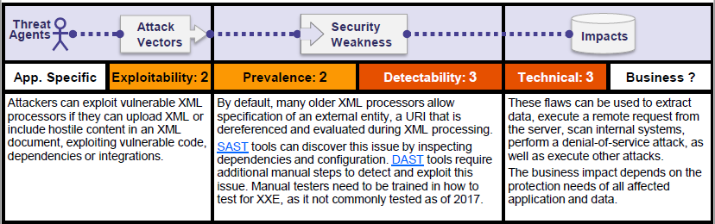
A4: 2017 – XML External Entities (XXE)
Risk Matrix

Slide 39
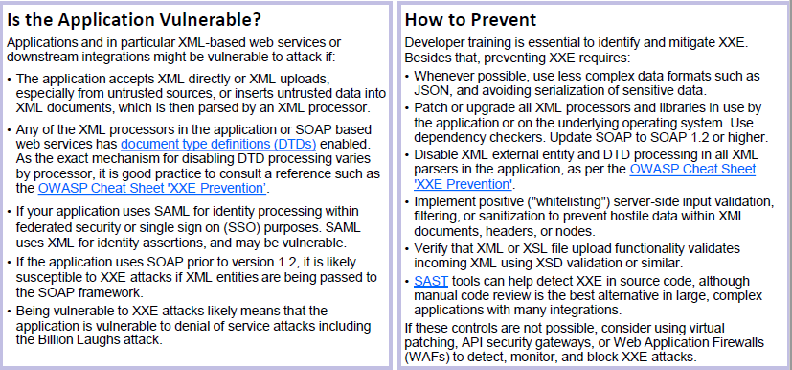
A4: 2017 – XML External Entities (XXE)

Slide 40
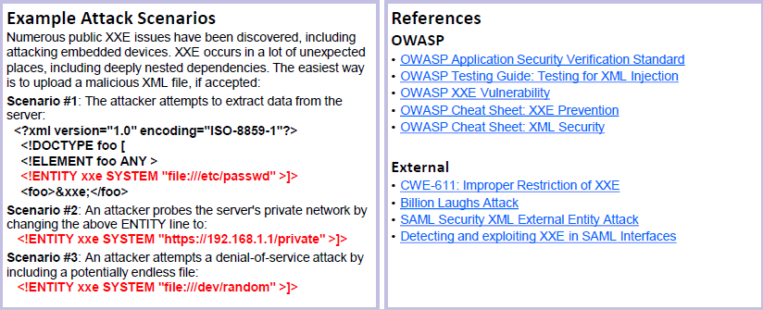
A4: 2017 – XML External Entities (XXE)

Slide 41
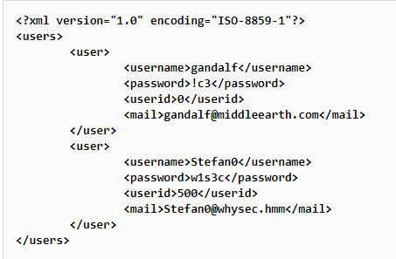
A4: 2017 – XML External Entities (XXE)
XML Injection
Let's suppose there is a web application using an XML style communication in order to perform user registration. This is done by creating and adding a new <user> node in an xmlDb file.
<xsl:stylesheet version="1.0" xmlns:xsl="http://www.w3.org/1999/XSL/Transform">
Discovery
The first step in order to test an application for the presence of a XML Injection vulnerability consists of trying to insert XML metacharacters (‘ “ < > <!--/--> &)

Slide 42
A4: 2017 – XML External Entities (XXE)
XML Entity
An XML External Entity attack is a type of attack against an application that parses XML input. This attack occurs when XML input containing a reference to an external entity is processed by a weakly configured XML parser. This attack may lead to the disclosure of confidential data, denial of service, server side request forgery, port scanning from the perspective of the machine where the parser is located, and other system impacts.
The XML 1.0 standard defines the structure of an XML document. The standard defines a concept called an entity, which is a storage unit of some type. There are a few different types of entities, external general/parameter parsed entity often shortened to external entity, that can access local or remote content via a declared system identifier. The system identifier is assumed to be a URI that can be dereferenced (accessed) by the XML processor when processing the entity. The XML processor then replaces occurrences of the named external entity with the contents dereferenced by the system identifier. If the system identifier contains tainted data and the XML processor dereferences this tainted data, the XML processor may disclose confidential information normally not accessible by the application. Similar attack vectors apply the usage of external DTDs, external stylesheets, external schemas, etc. which, when included, allow similar external resource inclusion style attacks.

Slide 43
A4: 2017 – XML External Entities (XXE)
Attacks can include disclosing local files, which may contain sensitive data such as passwords or private user data, using file: schemes or relative paths in the system identifier. Since the attack occurs relative to the application processing the XML document, an attacker may use this trusted application to pivot to other internal systems, possibly disclosing other internal content via http(s) requests or launching a CSRF attack to any unprotected internal services. In some situations, an XML processor library that is vulnerable to client-side memory corruption issues may be exploited by dereferencing a malicious URI, possibly allowing arbitrary code execution under the application account. Other attacks can access local resources that may not stop returning data, possibly impacting application availability if too many threads or processes are not released.
Risk Factors
The application parses XML documents.
Tainted data is allowed within the system identifier portion of the entity, within the document type declaration (DTD).
The XML processor is configured to validate and process the DTD.
The XML processor is configured to resolve external entities within the DTD.

Slide 44
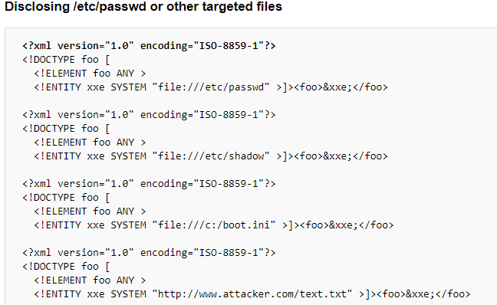
A4: 2017 – XML External Entities (XXE)

Slide 45
A4: 2017 – XML External Entities (XXE)
Prevention techniques
General Guidance
The safest way to prevent XXE is always to disable DTDs (External Entities) completely. Depending on the parser, the method
should be similar to the following:
factory.setFeature("http://apache.org/xml/features/disallow-doctype-decl", true);
Disabling DTDs also makes the parser secure against denial of services (DOS) attacks such as Billion Laughs.
If it is not possible to disable DTDs completely, then external entities and external document type declarations must be
disabled in the way that’s specific to each parser.
Detailed XXE Prevention guidance for a number of languages and commonly used XML parsers in those languages is provided below.

Slide 46
A4: 2017 – XML External Entities (XXE)
Prevention techniques
In C/C++
libxerces-c
Use of XercesDOMParser do this to prevent XXE:
XercesDOMParser *parser = new XercesDOMParser;
parser->setCreateEntityReferenceNodes(false);
SAXParser* parser = new SAXParser;
parser->setDisableDefaultEntityResolution(true);
SAX2XMLReader* reader = XMLReaderFactory::createXMLReader();
parser->setFeature(XMLUni::fgXercesDisableDefaultEntityResolution, true);

Slide 47
A4: 2017 – XML External Entities (XXE)
Prevention techniques
Java: Based on nature of parser used (DOM, SAX, Stax, etc) method will be changed bit based on parse configuration
DocumentBuilderFactory dbf = DocumentBuilderFactory.newInstance();
String FEATURE = null;
try {
// This is the PRIMARY defense. If DTDs (doctypes) are disallowed, almost all XML entity attacks are prevented
// Xerces 2 only - http://xerces.apache.org/xerces2-j/features.html#disallow-doctype-decl
FEATURE = "http://apache.org/xml/features/disallow-doctype-decl";
dbf.setFeature(FEATURE, true);
// If you can't completely disable DTDs, then at least do the following:
// Xerces 1 - http://xerces.apache.org/xerces-j/features.html#external-general-entities
// Xerces 2 - http://xerces.apache.org/xerces2-j/features.html#external-general-entities
// JDK7+ - http://xml.org/sax/features/external-general-entities
FEATURE = "http://xml.org/sax/features/external-general-entities";
dbf.setFeature(FEATURE, false);

Slide 48
A4: 2017 – XML External Entities (XXE)
Prevention techniques
Java: Based on nature of parser used (DOM, SAX, Stax, etc) method will be changed bit based on parse configuration
// Xerces 1 - http://xerces.apache.org/xerces-j/features.html#external-parameter-entities
// Xerces 2 - http://xerces.apache.org/xerces2-j/features.html#external-parameter-entities
// JDK7+ - http://xml.org/sax/features/external-parameter-entities
FEATURE = "http://xml.org/sax/features/external-parameter-entities";
dbf.setFeature(FEATURE, false);
// Disable external DTDs as well
FEATURE = "http://apache.org/xml/features/nonvalidating/load-external-dtd";
dbf.setFeature(FEATURE, false);
// and these as well, per Timothy Morgan's 2014 paper: "XML Schema, DTD, and Entity Attacks"
dbf.setXIncludeAware(false);
dbf.setExpandEntityReferences(false);

Slide 49
A5: 2017 – Broken Access Control
What is Broken Access Control
Access control, sometimes called authorization, is how a web application grants access to
content and functions to some users and not others. These checks are performed after
authentication, and govern what ‘authorized’ users are allowed to do. Access control sounds
like a simple problem but is insidiously difficult to implement correctly.
A web application’s access control model is closely tied to the content and functions that the
site provides. In addition, the users may fall into a number of groups or roles with different
abilities or privileges.

Slide 50
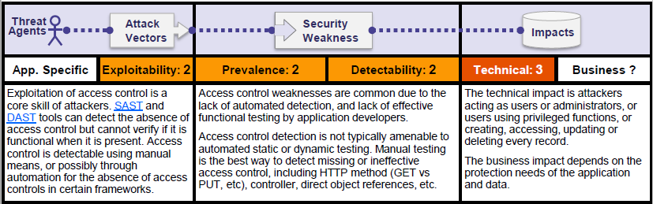
A5: 2017 – Broken Access Control
Risk Matrix

Slide 51
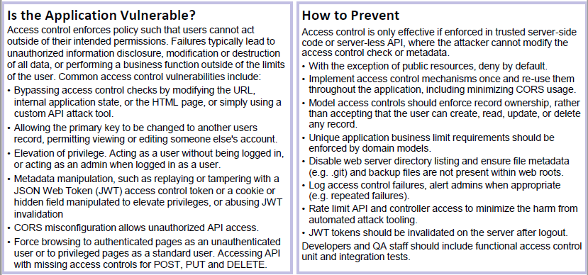
A5: 2017 – Broken Access Control

Slide 52
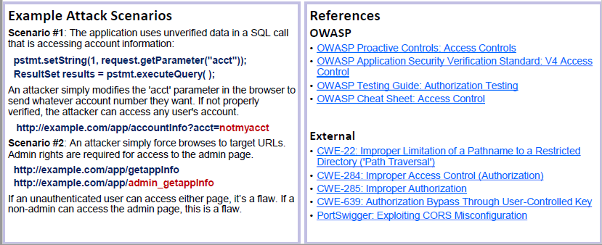
A5: 2017 – Broken Access Control

Slide 53
A5: 2017 – Broken Access Control
MISSING FUNCTION LEVEL ACCESS CONTROL
How do you protect access to URLs (pages)?
Or functions referenced by a URL plus parameters ?
This is part of enforcing proper “authorization”
A common mistake …
Displaying only authorized links and menu choices
This is called presentation layer access control, and doesn’t work
Attacker simply forges direct access to ‘unauthorized’ pages
Typical Impact
Attackers invoke functions and services they’re not authorized for
Access other user’s accounts and data
Perform privileged actions

Slide 54
A5: 2017 – Broken Access Control
MISSING FUNCTION LEVEL ACCESS CONTROL ILLUSTRATED
Attacker notices the URL indicates his/her role
/user/getAccounts
Attacker modifies the role to another directory (role)
/admin/getAccounts, or
/manager/getAccounts
Attacker views more accounts than just their own
URL plus parameter value(s) which indicate which function is being accessed
e.g., site/somedir/somepage?action=transferfunds

Slide 55
A5: 2017 – Broken Access Control
PREVENTING BROKEN ACCESS ISSUES
All Access control checks must be enforced on every request for every function.
Access control checks must be enforced on a trusted system (e.g., the server).
All authorization checks must be conducted at the time a URL or function is actually requested.
Authorization decisions must not be based on the checks done on previous pages.
Applications must disallow requests to unauthorized page types (e.g., config files, log files, source files, etc.)
Application must validate that all required entry conditions and authorization are met before the privileged function is accessed. An example of this context dependent access control will be a 5 stage shopping cart application, with the user being in the second stage. Access control will not allow the user to jump into 4th stage if the 3rd stage has not been completed.
Additional Standards from JAVA Technology
All Access control checks must be enforced on every request for restricted URLs using:
External filter, like Java EE web.xml.

Slide 56
A6: 2017 – Security Misconfiguration
What is Security Misconfiguration
Security Misconfiguration arises when Security settings are defined, implemented, and
maintained as defaults. Good security requires a secure configuration defined and deployed
for the application, web server, database server, and platform. It is equally important to have
the software up to date.

Slide 57
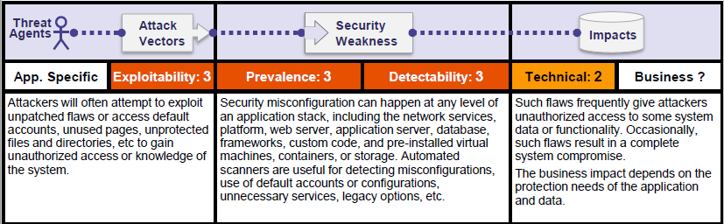
A6: 2017 – Security Misconfiguration
Risk Matrix

Slide 58
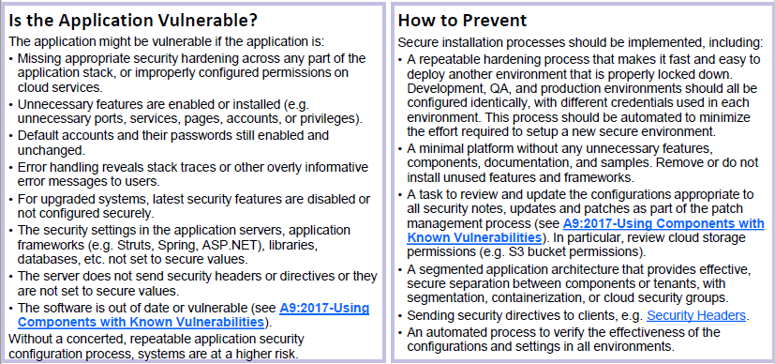
A6: 2017 – Security Misconfiguration

Slide 59
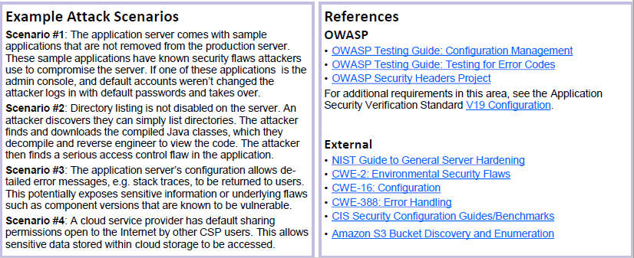
A6: 2017 – Security Misconfiguration

Slide 60
A6: 2017 – Security Misconfiguration
SECURITY MISCONFIGURATION
Web applications rely on a secure foundation
Everywhere from the OS up through the App Server
Is your source code a secret?
Think of all the places your source code goes
Security should not require secret source code
CM must extend to all parts of the application
All credentials should change in production
Typical Impact
Install backdoor through missing OS or server patch
Unauthorized access to default accounts, application functionality or data, or unused but accessible functionality due to poor server configuration

Slide 61
A6: 2017 – Security Misconfiguration
PREVENTING SECURITY MISCONFIGURATION
The application must operate within the securely configured infrastructure and must not reduce or weaken the infrastructure security by design or implementation.
Applications must be written to the specification of the most recently released critical security patch of the frameworks and systems component.
All software libraries and frameworks must have critical security patches and updates deployed. Refer to FIS’ security patching standard for established timelines.
Test code and parameters or any other functionality not intended for production, must be removed or turned off prior to deployment.
Different credentials must be used in development and production environments.
Applications must restrict direct access to confidential web resources from an unauthorized access. (for example, configuration files)
Untrusted data must be validated that it does not contain malicious characters before being added to any HTTP response header, in order to prevent vulnerabilities like HTTP response splitting. This includes line feed and new line characters, like %0d and %0a.

Slide 62
A6: 2017 – Security Misconfiguration
PREVENTING SECURITY MISCONFIGURATION – CONT.
For all frameworks, libraries, code snippets etc. default passwords must be changed.
For all frameworks, libraries, code snippets, databases, servers default accounts must be deleted
If it cannot be deleted then it must follow password change policy.
Applications must restrict direct access to confidential web resources.
Applications must configure custom error page(s) for common HTTP errors and runtime errors to prevent displaying default error information.
Additional Standards for JAVA Technology
Applications using axis2 library for web services must disable SOAP monitor module by removing any references such as <module ref="soapmonitor"/> in the web.xml file for production level environments.

Slide 63
A6: 2017 – Security Misconfiguration
Best practices for HTTP Server Header Configuration
Header always set X-XSS-Protection "1; mode=block"
Header always append X-Frame-Options DENY
Header always set Content-Security-Policy "default-src 'self' *.efunds.com 'unsafe-inline' 'unsafe-eval'"
Header always set Strict-Transport-Security "max-age=7776000; includeSubdomains; preload"
Header always set Cache-Control "private, no-cache, max-age=0, must-revalidate, no-store, proxy-revalidate, no-transform"
Header always set Pragma "no-cache"
Header always set Expires "0"
Header always set Public-Key-Pins "pin-sha256=\"C6XiP3TlslAO0jxTlPXXE/VTPajdIgJwX9na7D9KCFk=\"; max-age=5184000; includeSubDomains“

Slide 64
A7: 2017 – Cross-Site Scripting (XSS)
What is Cross Site Scripting
Cross-Site Scripting (XSS) attacks are a type of injection, in which malicious scripts are injected
into otherwise benign and trusted websites. XSS attacks occur when an attacker uses a web
application to send malicious code, generally in the form of a browser side script, to a different
end user. Flaws that allow these attacks to succeed are quite widespread and occur anywhere
a web application uses input from a user within the output it generates without validating or
encoding it.

Slide 65
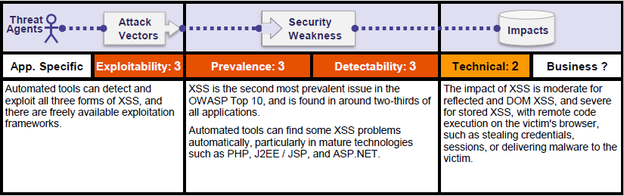
A7: 2017 – Cross-Site Scripting (XSS)
Risk Matrix

Slide 66
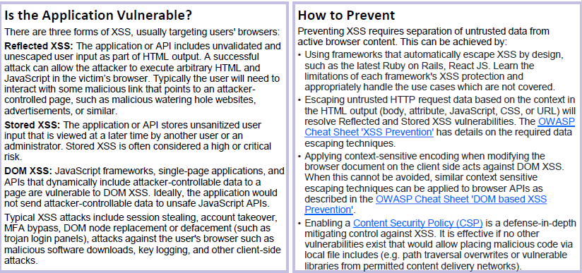
A7: 2017 – Cross-Site Scripting (XSS)

Slide 67
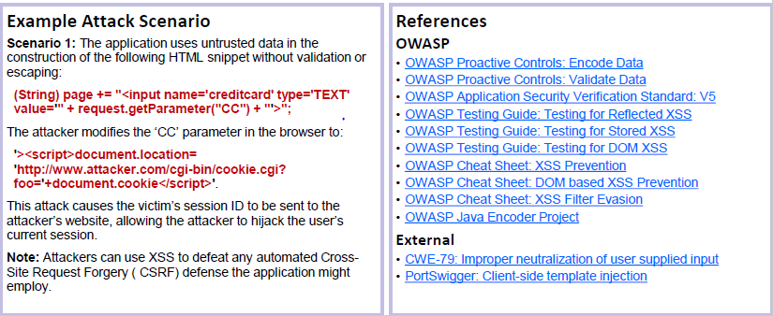
A7: 2017 – Cross-Site Scripting (XSS)

Slide 68
A8:2017 – Insecure Deserialization
What is Insecure Deserialization
Allows attackers to transfer a payload using serialized objects. This happens when integrity checks are not in place and deserialized data is not sanitized or validated.
Developing a web application sometimes requires you to transfer an object. In simple terms, the object contains a bunch of variables that in turn contain information. However, an object cannot be transferred directly, so it has be converted into something else first.
This conversion is called serialization. Serialization is the process of taking an object and translating it into plaintext. This plaintext can then be encrypted or signed, as well as simply used the way it is. The reverse process is called deserialization, i.e. when the plaintext is converted back to an object.

Slide 69
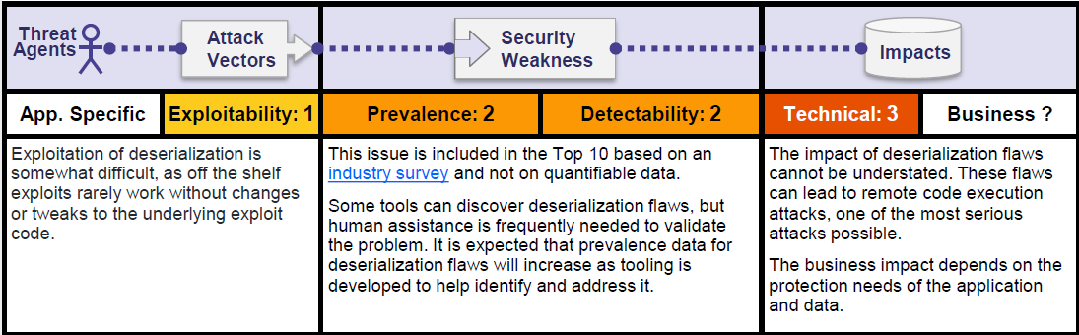
A8:2017 – Insecure Deserialization
Risk Matrix

Slide 70
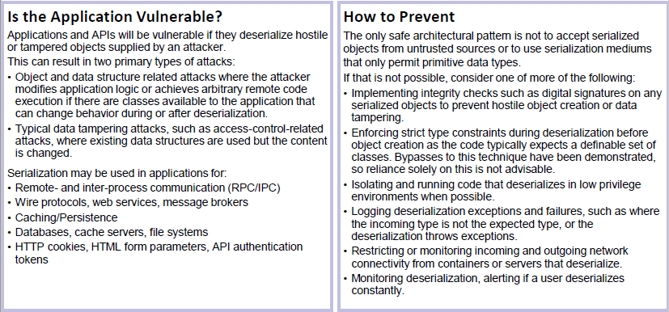
A8:2017 – Insecure Deserialization

Slide 71
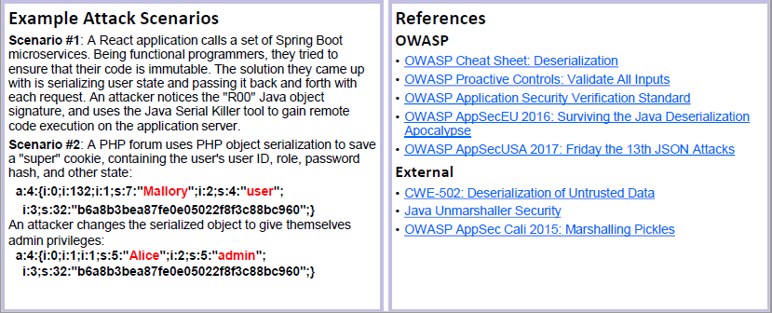
A8:2017 – Insecure Deserialization

Slide 72
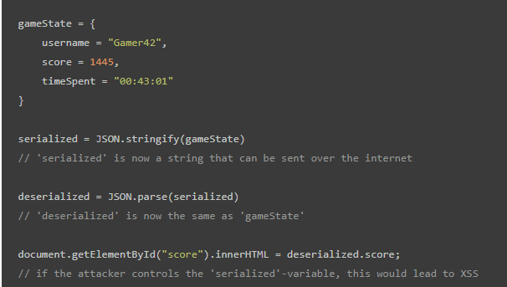
A8:2017 – Insecure Deserialization
Java Script example

Slide 73
A9:2017 – Using Components with Known Vulnerabilities
What is Components with Known Vulnerabilities
Known vulnerabilities are vulnerabilities that were discovered in open source components and published in the NVD, security advisories or issue trackers. From the moment of publication , a vulnerability can be exploited by hackers who find the documentation. According to OWASP, the problem of using components with known vulnerabilities is highly prevalent. Moreover, use of open source components is so widespread that many development leaders don't even know what they have. The possible impact of open source vulnerabilities ranges from minor to some of the largest breaches known

Slide 74
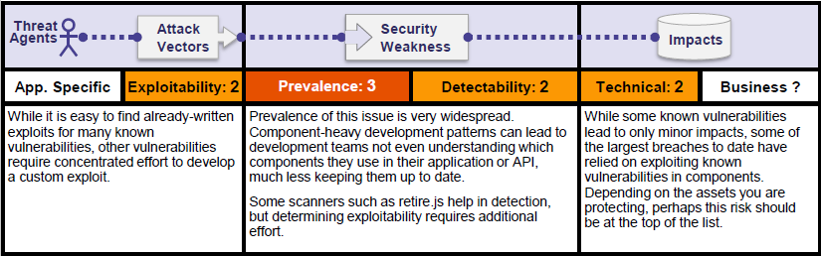
A9:2017 – Using Components with Known Vulnerabilities
Risk Matrix

Slide 75
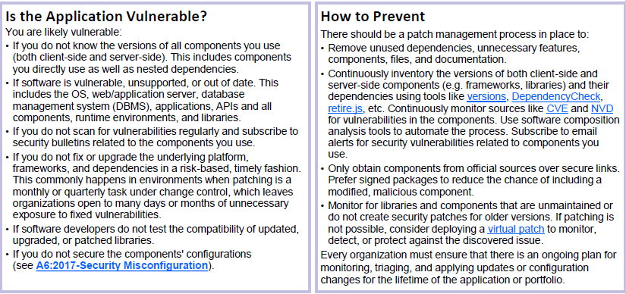
A9:2017 – Using Components with Known Vulnerabilities

Slide 76
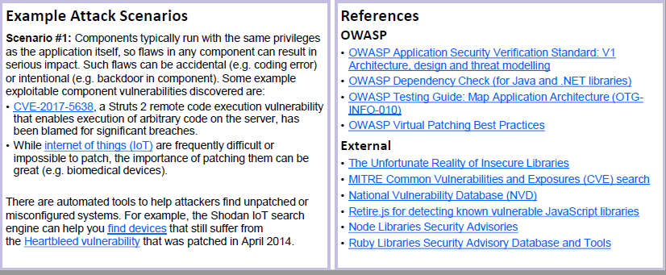
A9:2017 – Using Components with Known Vulnerabilities

Slide 77
A9:2017 – Using Components with Known Vulnerabilities
USING COMPONENTS WITH KNOWN VULNERABILITIES
Vulnerable Components Are Common
Some vulnerable components (e.g., framework libraries) can be identified and exploited with automated tools
Scope
Commercial 3rd party s/w components
Typical Impact
Full range of weaknesses is possible, including injection, broken access control, XSS ...
This expands the threat agent pool beyond targeted attackers to include chaotic actors
The impact could range from minimal to complete host takeover and data compromise
Open source s/w - Refer to Open Source Software policy for definition.
Widespread
Virtually every application has these issues because most development teams don’t focus on ensuring their components/libraries are up to date
In many cases, the developers don’t even know all the components they are using, never mind their versions. Component dependencies make things even worse

Slide 78
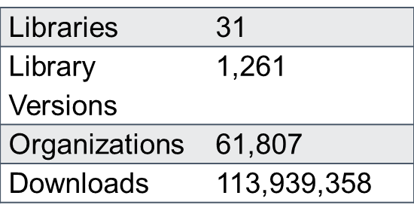
A9:2017 – Using Components with Known Vulnerabilities
USING COMPONENTS WITH KNOWN VULNERABILITIES
29 MILLION vulnerable downloads in 2011

Slide 79
A9:2017 – Using Components with Known Vulnerabilities
PREVENTING KNOWN VULNERABILITIES IN COMPONENTS
Third party software components must be evaluated for potential vulnerabilities it may introduce into an application. [Effective March 31st, 2016]
Line of business development teams must have monitoring plans for all critical and high security vulnerabilities. [Effective Sep 30th, 2015]
The monitoring must happen at least quarterly using the National Vulnerabilities Database.
Line of business development teams must have a remediation plan for all critical and high security vulnerabilities. [Effective Oct 31st, 2015]
If there are critical security patches released for third party components, libraries and functions used by the applications then they must be upgraded to include that patch.

Slide 80
A9:2017 – Using Components with Known Vulnerabilities
PREVENTING KNOWN VULNERABILITIES IN COMPONENTS – CONT.
Functionality of the components which have critical security issues must have the solution applied as soon as commercially reasonable as a critical deployment. In the event that no solution or patch is available, mitigating controls must be put in place until such a patch becomes available by the vendor.
Remediation is required if a vulnerable function of the component is used. Where appropriate, security wrappers around the components should be added to disable unused functionality and secure weak or vulnerable aspects of the component.
Inventory clients/servers
Downloads
Plan, Monitor, Patch and Config
FIS Solution: Black Duck for keep track for OSS components.
https://fis.blackducksoftware.com/
https://cwe.mitre.org/
https://nvd.nist.gov/

Slide 81
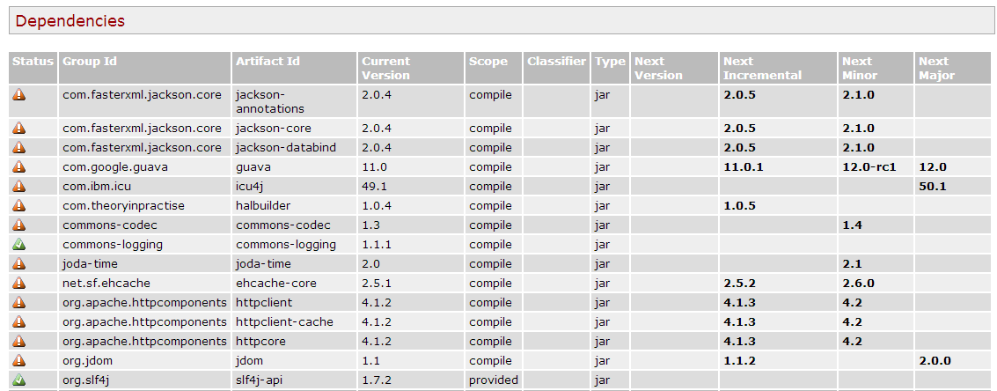
A9:2017 – Using Components with Known Vulnerabilities
KNOWN VULNERABILITIES IN COMPONENTS ILLUSTRATED
Output from the Maven Versions Plugin – Automated Analysis of Libraries’ Status against Central repository
Most out of Date!
Details Developer Needs
This can automatically be run EVERY TIME software is built!!

Slide 82
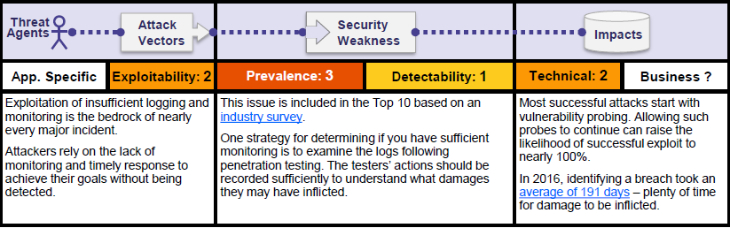
A10:2017 – Insufficient Logging & Monitoring
Risk Matrix

Slide 83
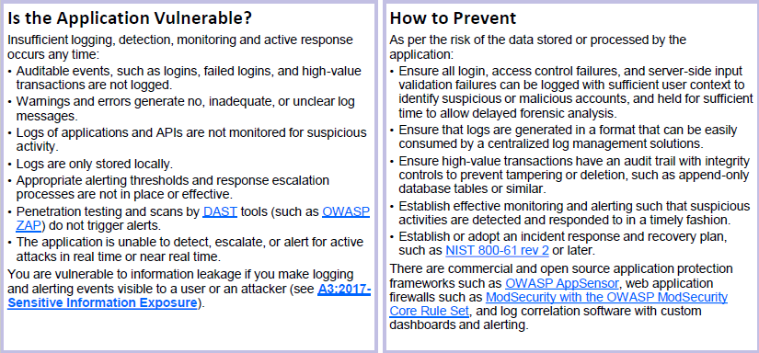
A10:2017 – Insufficient Logging & Monitoring

Slide 84
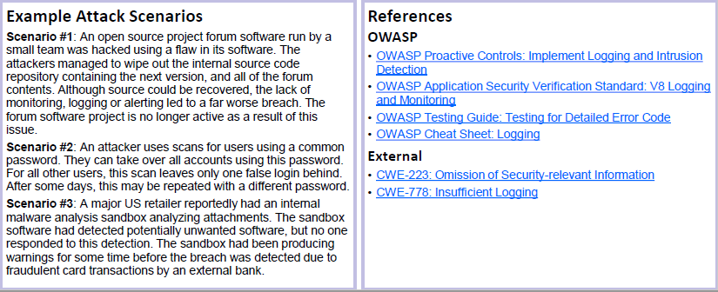
A10:2017 – Insufficient Logging & Monitoring

Slide 85
REFERENCE
REFERENCE
Develop Secure Code
Follow the best practices in OWASP’s Guide to Building Secure Web Applications
https://www.owasp.org/index.php/Guide
And the cheat sheets: https://www.owasp.org/index.php/Cheat_Sheets
Use OWASP’s Application Security Verification Standard as a guide to what an application needs to be secure
https://www.owasp.org/index.php/ASVS
Review Your Applications
Review your applications yourselves following OWASP Guidelines
OWASP Code Review Guide: https://www.owasp.org/index.php/Code_Review_Guide
OWASP Testing Guide: https://www.owasp.org/index.php/OWASP_Testing_Project

Slide 86
Questions
Questions?
Thank you
Venkatesh Reddy Madduri

